Slide 1


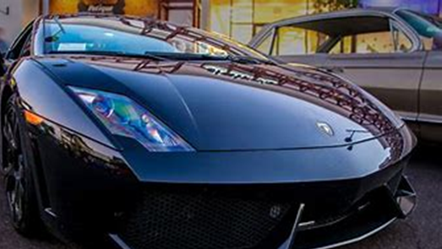
Task 11:
Forces & Vehicle Safety
By Kyla Vearing

Slide 2

Increasing the time of the collision
Increasing the collision time and/ or the time it takes the vehicle to stop allows the force of impact to be minimised so as to prevent catastrophic injury.
Increasing the collision time means having things like crumple zones and airbags to reduce the force made on the person driving .
The crumple zones allow the force to be captured thus leaving less force to impact the driver or passengers.

Slide 3
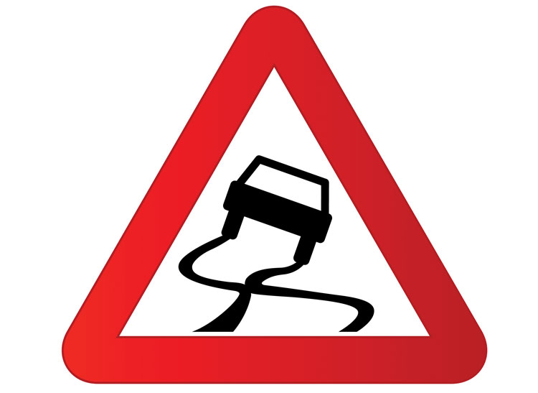
Spreading the forces of impact over the largest possible area and ensuring stability of the vehicle
Crumple zones also help in redistributing a forces impact. It directs the force away from the occupants of the car because the force has to go somewhere.
Functions like ABS in cars allow for more secure stability. It stops the car breaks from locking so drivers can easily swerve around obstacles or turn corners.
The crumple zones that are created absorb as much force as possible to protect the components as well as the occupants inside the vehicle.

Slide 4
Minimising contact of the person with the interior of the vehicle
The seat belts in the vehicle keep the occupant from jostling/moving too much in the event of a sudden stop.
They’re designed to stretch slightly to allow movement which may occur in a collision. This lengthens the time it takes for the body’s movement to return to its original state, reducing it’s force.
Airbags also lengthens the time it takes for the heads momentum to return to its original position, which also reduces the forces acting on it as well as serving as a cushion to help prevent injuries that may occur to the head.

Slide 5
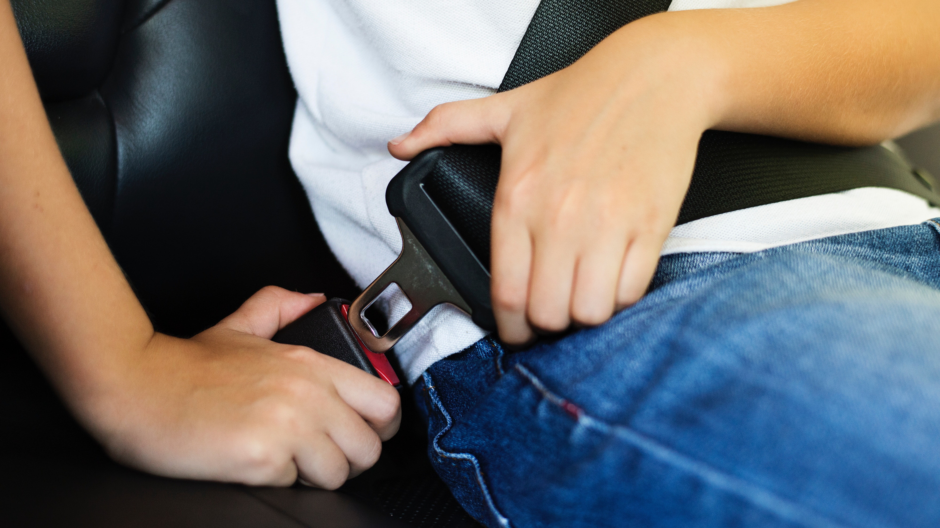
Keeping the person inside the vehicle
Newton's Law of Inertia states that an object will remain at rest or in a constant motion unless acted upon an unbalanced / external force.
The seatbelts prevent persons from flying out the windscreen, windows, doors if they somehow open upon impact, or the top of cars for instances like convertibles.

Slide 6
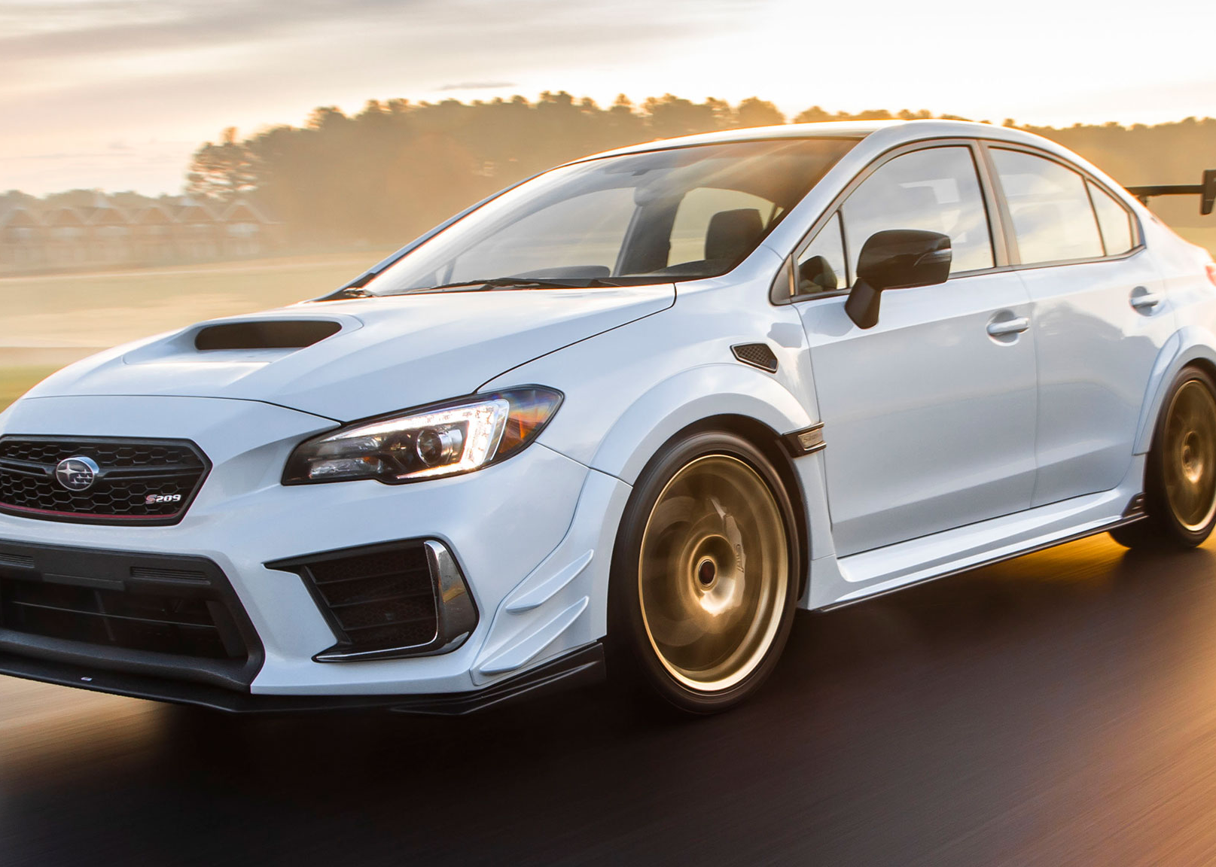
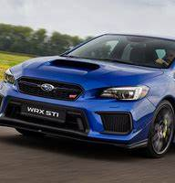
Subaru WRX safety features

Slide 7
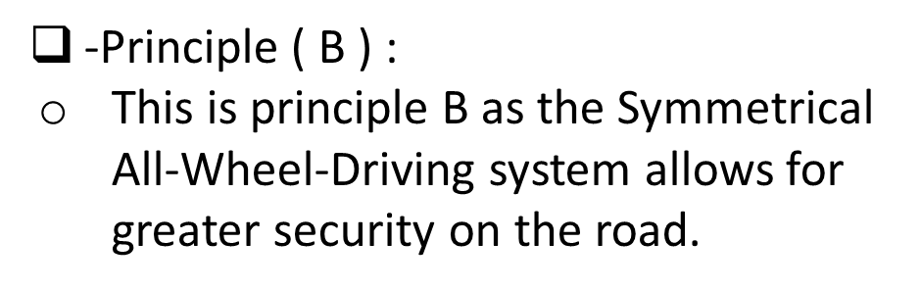
Safety features that comply with previously mentioned physics principle/s:
-Safety Feature 1 :
SYMMETRICAL ALL-WHEEL DRIVING
This allows all the weight when driving to be evenly spread amongst all the wheels.
“This provides traction where front- or rear-wheel-drive cars falter.”

Slide 8
Safety Feature 2 :
WHIPLASH REDUCING FRONT SEATS
These seats, as well as the head restraints (head rests), are energy-absorbing.
This helps to better protect front occupants from injury during collision from the rear end.
-Principle ( B ) :
Sitting in the front seats means that the seats themselves are the largest area absorbing impact if we focus on that alone. The shock absorbing seats are taking in most of the force of impact so the driver and from passenger stay safe when hit from behind.

Slide 9
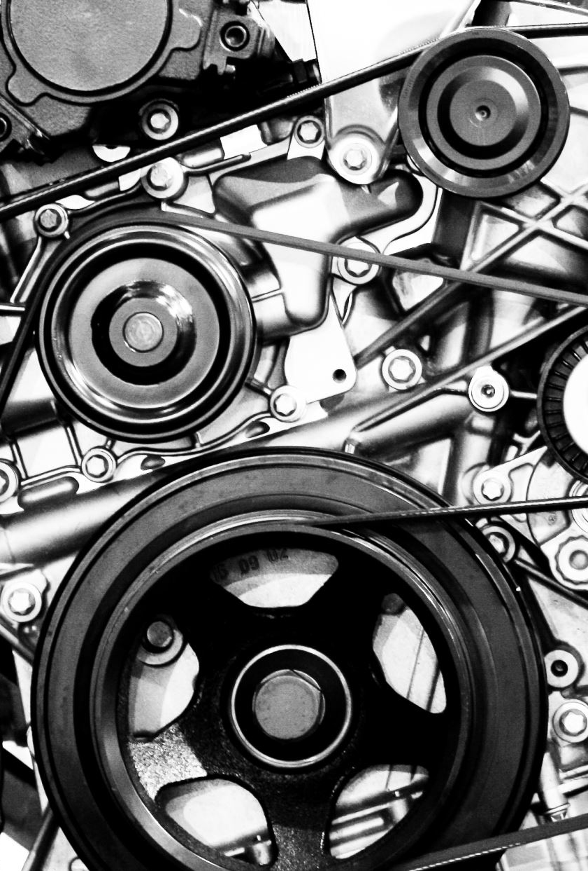
-Safety Feature 3 :
SUBARU BOXER ENGINE
The boxer engine provides stability and balancing for turning corners.
“It represents Subaru’s dedication to advanced driving safety”.
Principle ( B ) :
This is principle B as the boxer engine provides and ensures stability for turning corners and on wet roads

Slide 10
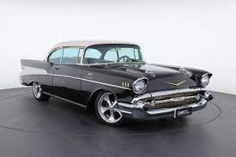
Chosen vehicle from before the 60’s:
1950’s Chevrolet Bel Air
The Chevrolet Bel Air didn’t have seatbelts or padded dashboards until 1956 which would’ve very dangerous in the event of a car crash as an occupants injuries would’ve been severe without them.
It also didn’t have crumple zones and airbags as well, which lowers the safety rate of an occupant in the vehicle significantly.

Slide 11
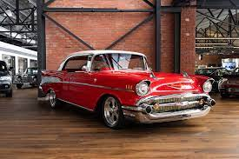
Unsafe features with physics principles:
With the lack of seatbelts, Principle D applies most to this. In the event of a collision, the occupant/s in the front seats would have flown out the car and been severely injured.
It also didn’t have airbags which complies with Principle C. Without the airbags, occupant/s may suffer injury due to the lack of cushioning from the hard interior of the vehicle.

Slide 12
The role of safety in a car design:
The role of safety in a design of a car provides the best possible chance of survival to the occupants who ride in the vehicle.
With the new technology and systems put into each new design that help the vehicle, this also helps the driver become more aware as well as save the vehicle itself if it were to get into a collision.
Cars are constantly developing into something safer and technologically helpful that it may save the occupants that are in it and it may even help avoid a collision all together.

Slide 13
References:
Chevrolet bel air safety features timeline
Explore the Subaru WRX Safety Features That Keep You Protected (subaru-global.com)

